Slide 1
長腿叔叔 Run for you
9916026 鍾明宏
9916031 趙偉甯
9916037 曹家瑞

Slide 2
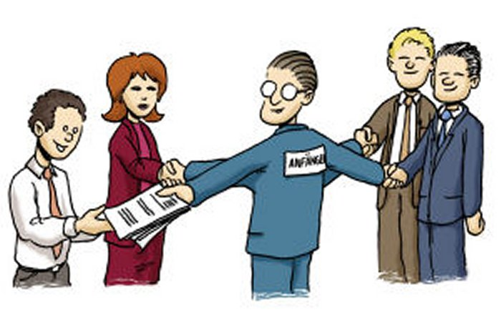
What is it about?
It’s a website for user who can easily find or post a job

Slide 3
Features?
An easy employ website for giving or receiving the task
Especially for short-time and reachable job.
Everyone is not only employee but employer.
Rank from two situations.
Log in with Facebook account.(maybe more)
Quick and brief introduction for user
Specific location chosen
(Google Map for reference)

Slide 4

Log in (with FB account)

Slide 5
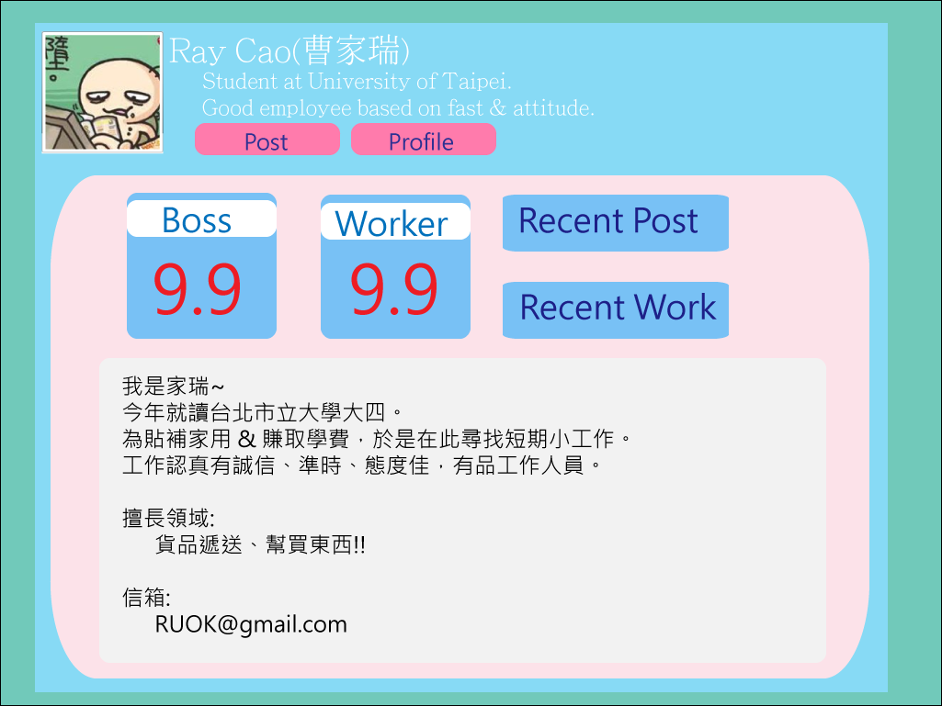
Main Page (Address chosen)

Slide 6
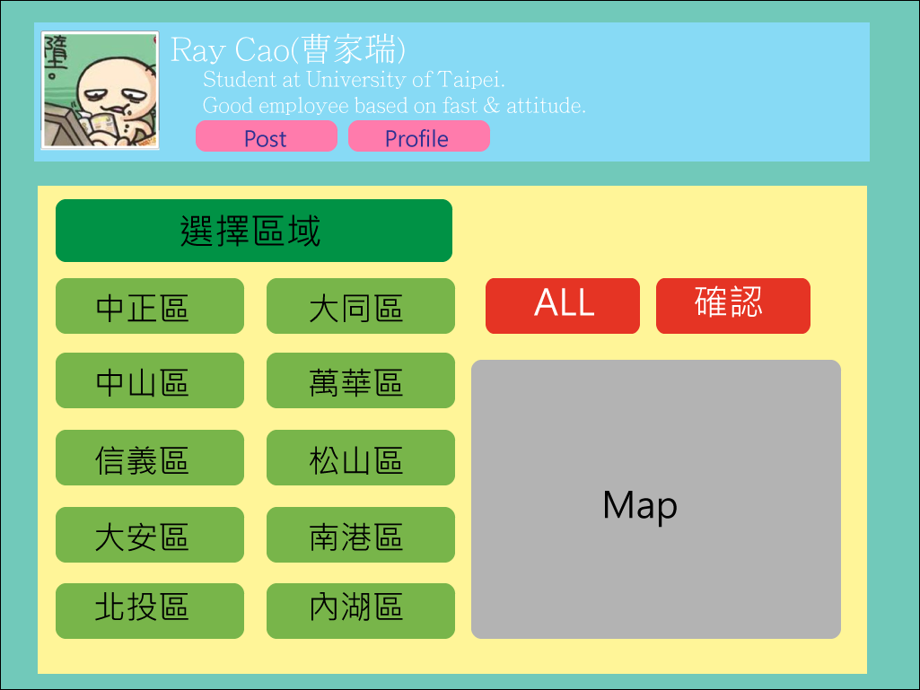
Personal Profile

Slide 7
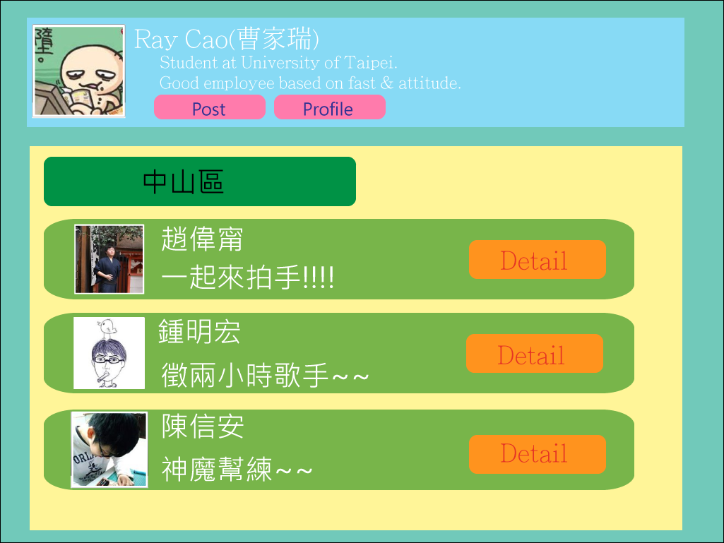
Post

Slide 8
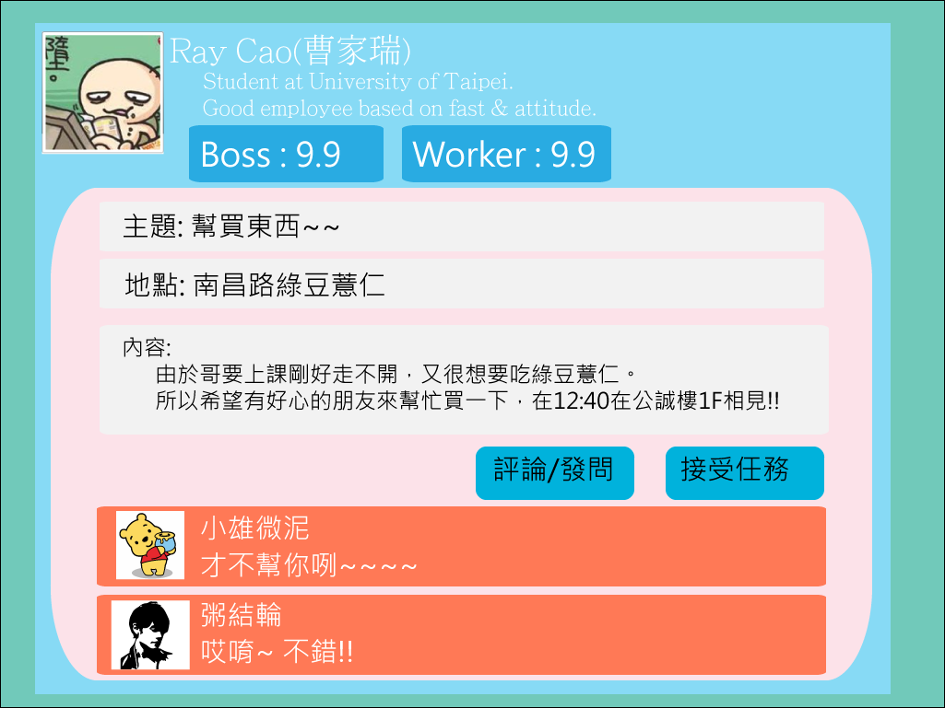
Task

Slide 9

Task post and accept (Events between Two)
A
(Post)
B (Accept)
1. A post a Task
2. B deliver acception to B
3. A choose which employee , send message back to B
----------------------------- Done -----------------------------------
4. B send the finish message to A
5. A confirm the request , rank for B
(Time for pay… , Rank for Boss)
6. B confirm the payment , rank for A
(Rank for employee)

Slide 10

What we need ?
The tools:
1. Html 、 JavaScript 、 CSS 、 PHP 、MySQL
2. Server construct: AppServ、wamp
Platform: Apache
Social API: Facebook API

Slide 11
Difficulties we may meet?
PHP and Database
(Data read/write)
Task Post and Accept
(Events between two offices)
Post Board
Server
PHP
Show

Slide 12
THANK YOU !!!

